Slide 1

Digital Portfolio
STUDENT NAME: A. PETER FRANCO
REGISTER NO : 212402402
NMID: 84CF008147E7B5892764508ACA0C5B94
DEPARTMENT: BCA
COLLEGE: COLLEGE/ UNIVERSITY : AGURCHAND MANMULL JAIN COLLEGE , UNIVERSITY OF MADRAS
1

Slide 2

PROJECT TITLE
DIGITAL STUDENT PORTFOLIO
2

Slide 3



AGENDA
Problem Statement
Project Overview
End Users
Tools and Technologies
Portfolio design and Layout
Features and Functionality
Results and Screenshots
Conclusion
Github Link
3/21/2024 Annual Review
3

Slide 4

PROBLEM STATEMENT
There was a need to create a modern, visually appealing, and interactive personal portfolio website that not only highlights skills and projects but also leaves a memorable impression through animations and creative design.
4

Slide 5

PROJECT OVERVIEW
This project is a personal portfolio website for Peter Franco, designed with a neon-themed aesthetic, animations, and interactive elements. It showcases professional details such as an About section, Portfolio of projects, Skills visualization, and a Contact form, all wrapped in a responsive design.
5

Slide 6

WHO ARE THE END USERS?
Recruiters and hiring managers looking at Peter’s profile.
Potential clients seeking developers/designers.
Peers and collaborators exploring skills and projects.
General visitors interested in his creative work.
6

Slide 7

TOOLS AND TECHNIQUES
HTML5 – Structure of the webpage.
CSS3 – Styling, neon effects, animations, responsiveness.
JavaScript (Vanilla JS) – Interactivity (hamburger menu, sparkle button, animated background, skill bar animation).
Font Awesome – Icons for navigation, portfolio, and footer.
Google Fonts (Montserrat) – Typography.
7

Slide 8
POTFOLIO DESIGN AND LAYOUT
Header with Navigation – Fixed navbar with hamburger toggle for mobile.
Hero Section – Neon-text headline, typewriter effect, and interactive button with sparkles.
About Section – Introduction and background.
Portfolio Section – Grid layout with hover effects showcasing projects (E-commerce Website, Fitness App, Design System).
Skills Section – Animated skill bars with percentages.
Contact Section – Styled contact form.
Footer – Social media icons and copyright.
Extras – Animated background particles and “Back to Top” button.
8

Slide 9
FEATURES AND FUNCTIONALITY
Neon text glow and animated backgrounds.
Responsive navigation with a hamburger menu.
Typewriter animation for hero text.
Sparkle button effect.
Portfolio grid with hover transitions.
Animated skill bars that load on scroll.
Smooth “Back to Top” button.
Contact form for communication.

Slide 10
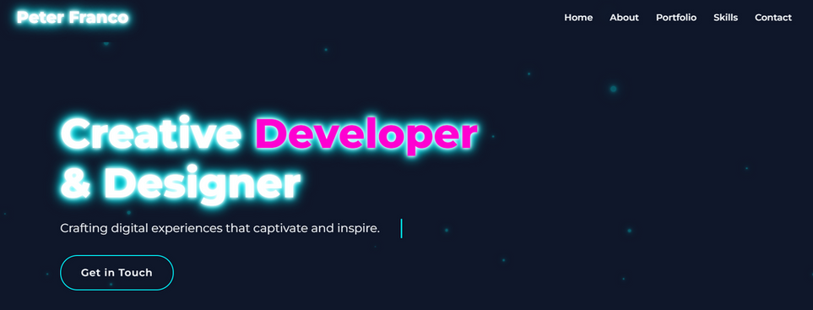
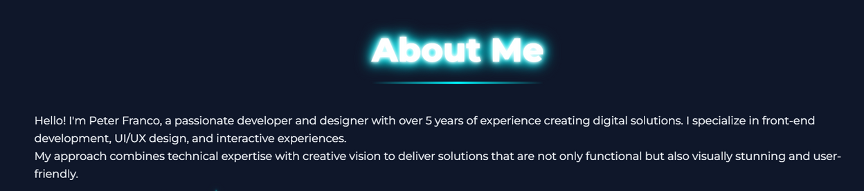
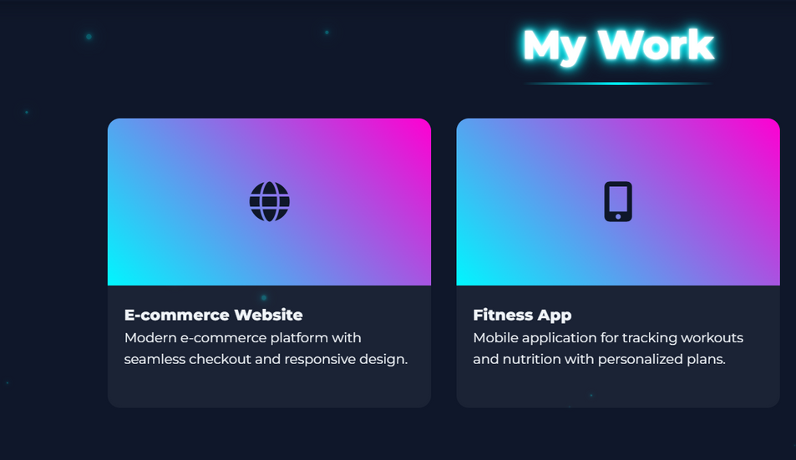
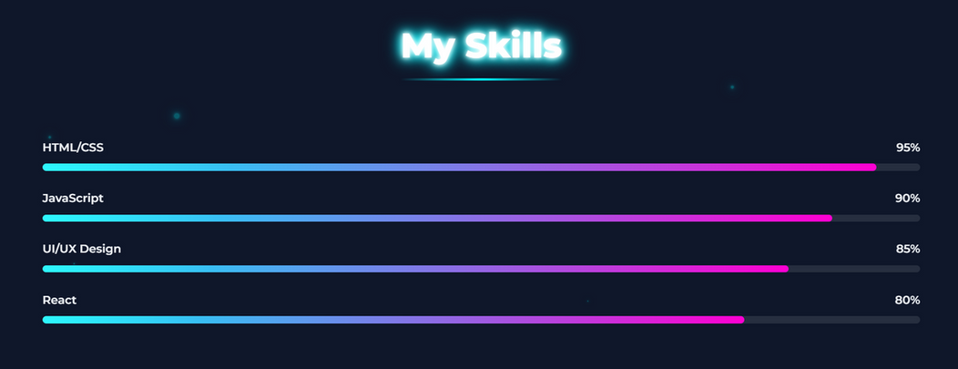
RESULTS AND SCREENSHOTS
3/21/2024 Annual Review
10

Slide 11
CONCLUSION
The portfolio effectively demonstrates creative design, technical skills, and interactivity, serving as a professional identity hub for Peter. It balances aesthetic appeal with functionality, ensuring accessibility across devices
11

Slide 12
GITHUB LIKN
Server link: https://github.com/24h210-cyber/TNSDC-FWD-DigitalPortfolio.git
Deployment link: https://24h210-cyber.github.io/TNSDC-FWD-DigitalPortfolio/
11

Slide 13
THANK YOU
11

